Slide 1
Video Classification and Action Recognition
Ravindersingh Rajpal (rkrajpal@ncsu.edu)
FNU Vivek (vvivek@ncsu.edu)

Slide 2
Content
Introduction
Dataset
C3D
I3D
TSN
Results
Demo
Limitations
Future Work

Slide 3
Introduction
Activity Recognition on UCF-101 dataset.
Create 3 DNN architectures for video classification.
3D ConvNet (C3D) - 2014
Two-Stream Inflated 3D ConvNet (I3D) - 2017
Temporal Segment Networks (TSN)- 2016
Pre-trained weights are used to initialize the models
Training and Validation loss analysis
Metric used: Accuracy

Slide 4
Dataset
UCF-101 dataset
Action recognition data set of realistic action videos from YouTube
101 action categories, 13320 videos
25 video groups (4-7 videos of an action)
5 action categories
Human-Object Interaction
Body-Motion Only
Human-Human Interaction
Playing Musical Instruments
Sports
https://www.crcv.ucf.edu/data/UCF101.php

Slide 5
3D ConvNet
“Learning Spatiotemporal Features with 3D Convolutional Networks”, Du Tran et al., Dec 2014.
Repurposing 3D convolutional networks as feature extractors.
Extensive search for best 3D convolutional kernel and architecture.
Using deconvolutional layers to interpret model decision.
Pre-trained weights are used to initialize the model and whole model is re-trained with a dense layer (softmax).

Slide 6
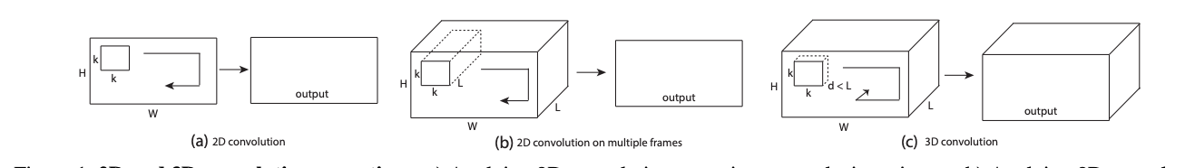
C3D - Architecture
Difference between 2D and 3D covolution
Source:https://arxiv.org/pdf/1412.0767.pdf
C3D architecture
Source:https://arxiv.org/pdf/1412.0767.pdf

Slide 7
C3D - Hyperparameters
Hyperparameter | Value
Learning Rate | 0.001
Dropout | 0.5
Batch size | 16
Number of frames per video | 16
Optimization function | SGD(momentum=0.9)

Slide 8
Two-Stream Inflated 3D ConvNet (I3D)
“Quo Vadis, Action Recognition? A New Model and the Kinetics Dataset”, Carreira et al., May 2017.
Combining 3D based models into two stream architecture leveraging pre-training.
Spatial stream input had frames stacked in time dimension.
Pre-trained weights are used to initialize the model and whole model is re-trained with a dense layer (softmax).

Slide 9
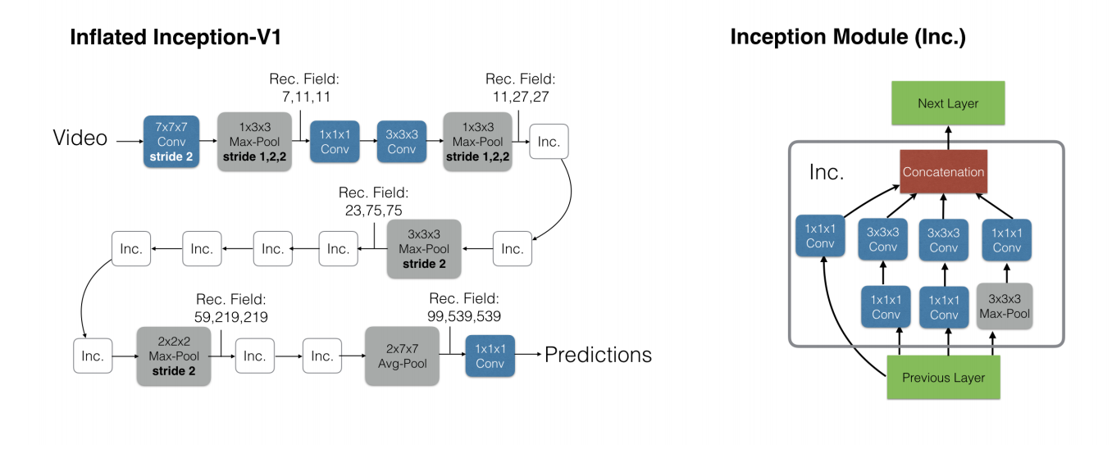
I3D - Architecture
Source: https://arxiv.org/pdf/1705.07750.pdf

Slide 10
I3D - Hyperparameters
Hyperparameter | Value
Learning Rate | 0.001
Dropout | 0.5
Batch size | 16
Number of frames per video for FRAME architecture | 16
Number of flows per video for FLOW architecture | 16
Optimization function | SGD(momentum=0.9)

Slide 11
Temporal Segment Networks
"Temporal Segment Networks: Towards Good Practices for Deep Action Recognition", Wang et al., Aug 2016.
Sample clips (segments) sparsely across video aimed at long range temporal modeling.
Combine scores of temporal and spatial streams by averaging across snippets.
Fuse score of final spatial and temporal scores and average across all classes.
Use pre-trained weights for Inception modules (we used Keras implementation).

Slide 12
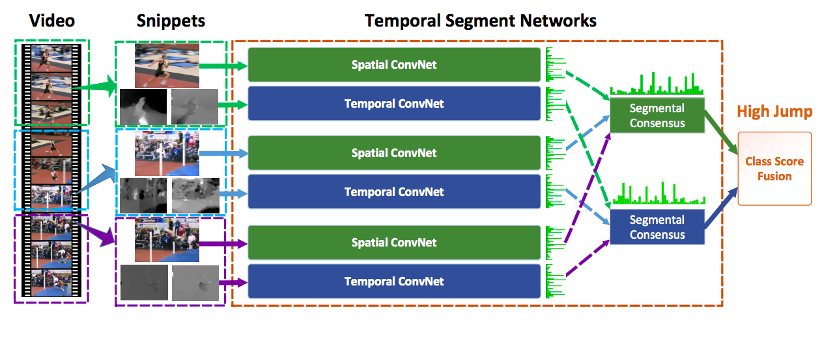
TSN - Architecture
Source: https://arxiv.org/pdf/1608.00859.pdf

Slide 13
TSN - Hyperparameters
Hyperparameter | Value
Learning Rate | 0-44 epochs: 1e-3, 45-200: 2e-3
Dropout | 0.5
Batch size | 16
Number of frames per video | 1
Number of flows per video | 1
Optimization function | Adam

Slide 14
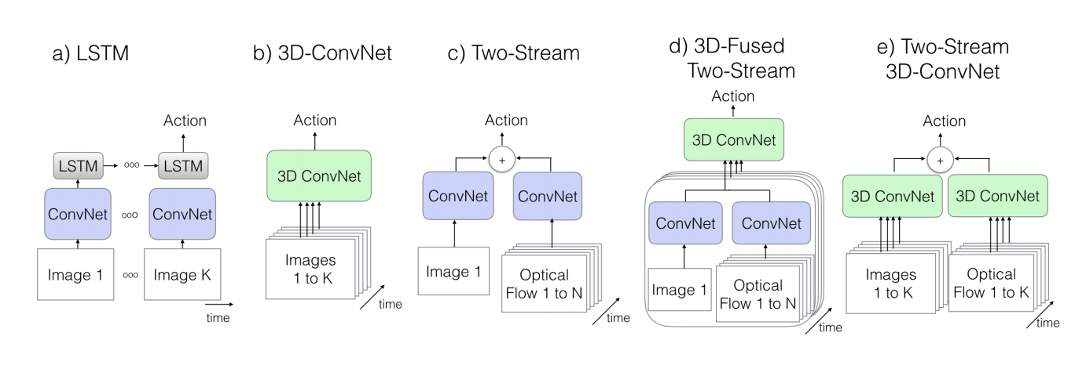
Different DNN Architectures
Different DNN architectures. We implemented (b) and (e)
Source: https://arxiv.org/pdf/1705.07750.pdf

Slide 15
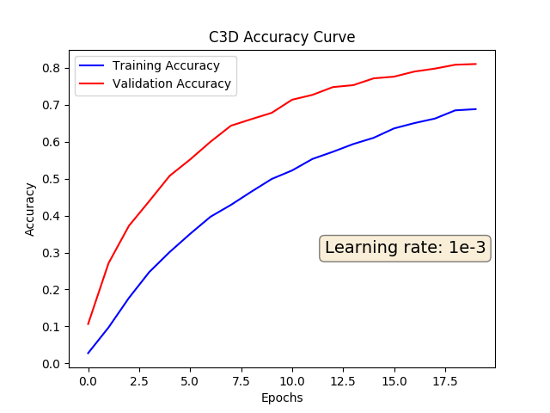
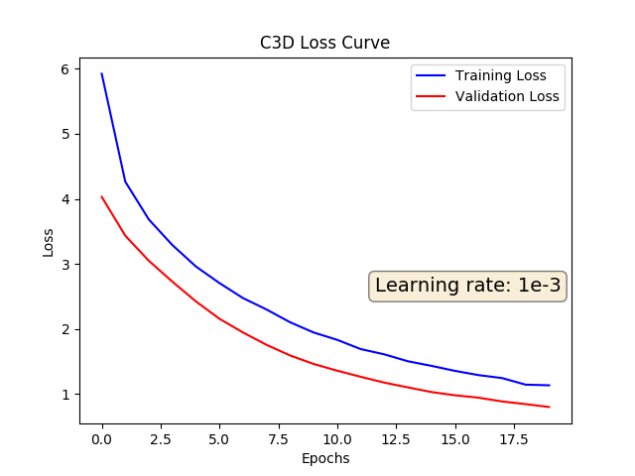
Training and Validation Graphs - C3D
Training time 556 secs/epoch

Slide 16
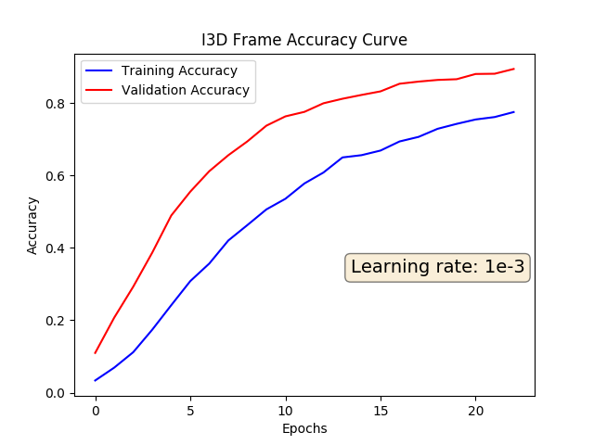
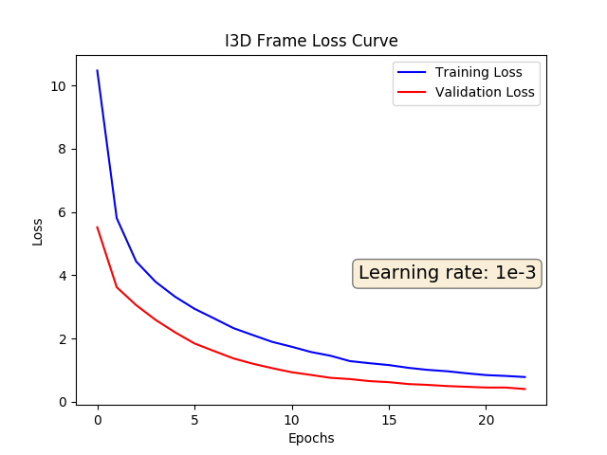
Training and Validation Graphs - I3D
Frames: Training time 628 secs/epoch

Slide 17
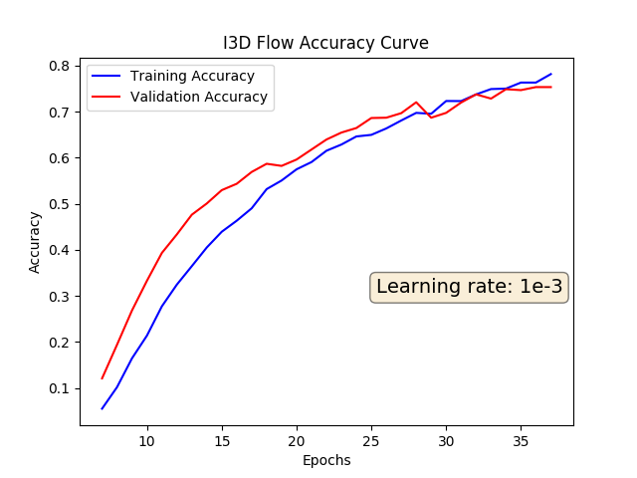
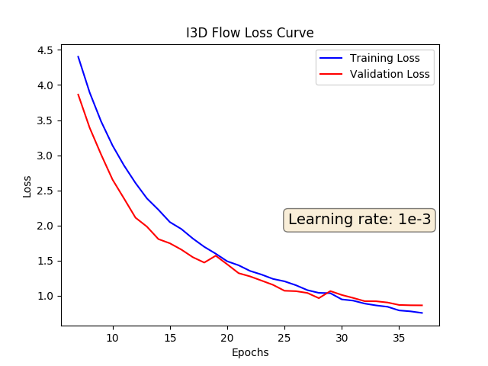
Training and Validation Graphs - I3D
Flows : Training time 2552 secs/epoch

Slide 18
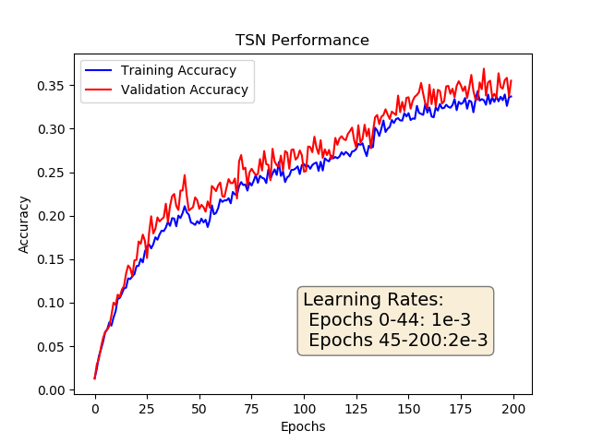
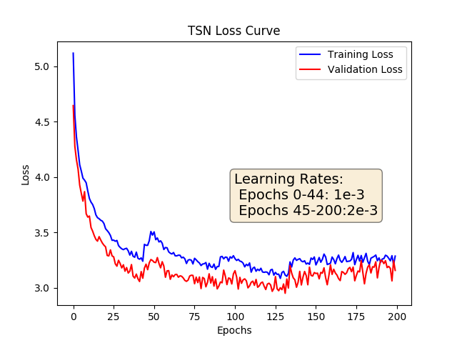
Training and Validation Graphs - TSN
Training time 435 secs/epoch

Slide 19
Results
DNN Architecture | Test Accuracy
C3D | 83.2%
I3D | 74.5%
TSN | 38.1%
Note: TSN was still undergoing training, after 200 epochs and 25 hours of training, we still see a rise in validation and training accuracy. Due to computational complexity and time constraints we decided to report the last achieved accuracy.

Slide 20
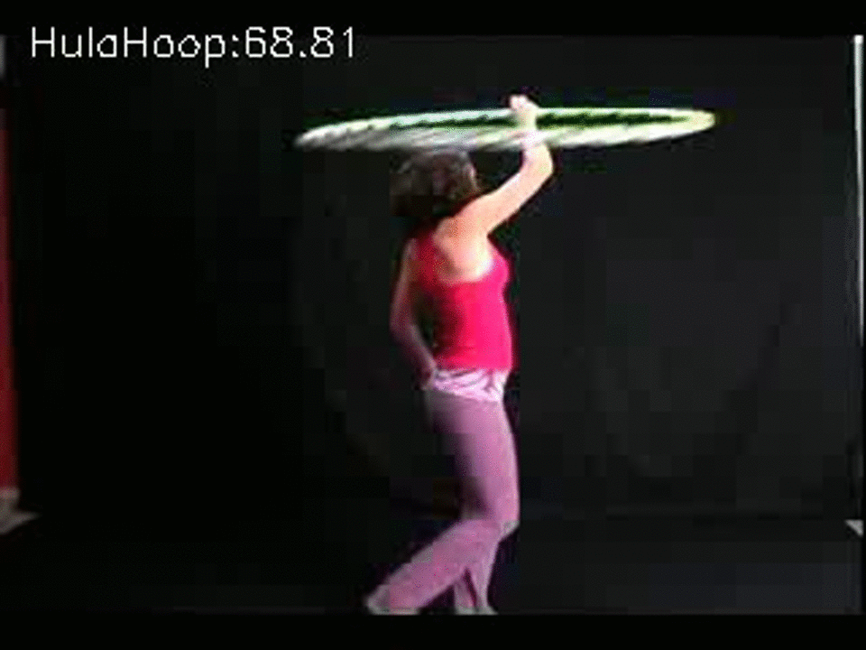

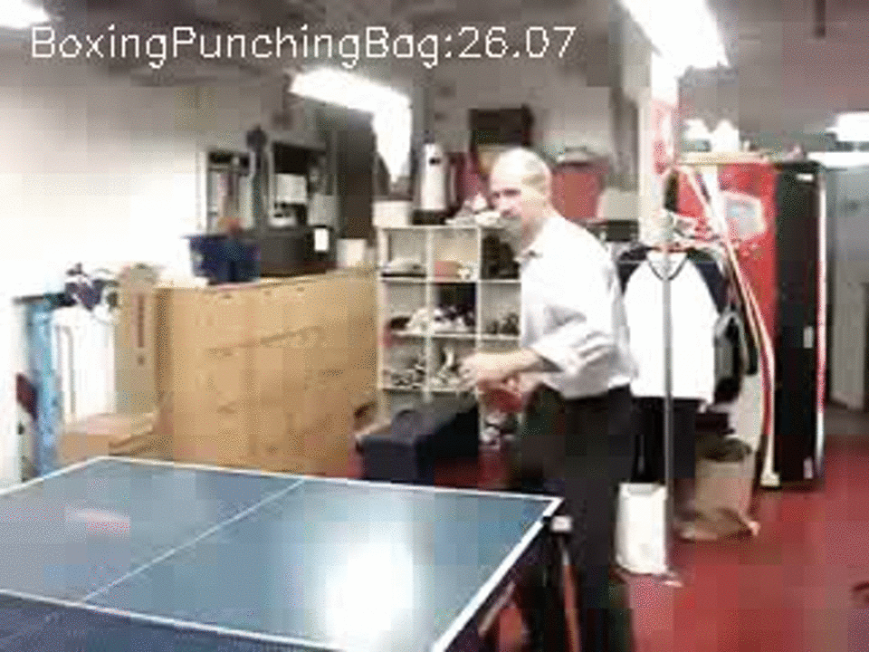
Demo
C3D model sample predictions

Slide 21
Limitations
C3D pre-trained architecture input required 112x112
224x224 frames were scaled down with a factor of 2
Long range temporal modelling still an issue.
I3D model required to take average output of Flow and Frame models
A simple average after taking argmax was reported
TSN had more than 300 million trainable params
Imagenet pre-trained weights were used
Model was trained for 25 hours for 200 epochs
Time and resource constraints
Increasing learning rate led to under-fitting
Keras implementation flaw for BatchNormalization layer

Slide 22
Future Work
Train C3D and I3D model for more epochs to get even better validation accuracy.
Implement TSN in Pytorch that has no issue with BatchNormalization.
Train TSN with better learning rate for more epochs.
Compare results with publicly available split results.

Slide 23
Thank You!

